Slide 1
§10.4: Connectivity
In an undirected graph, a path of length n from u to v is a sequence of adjacent edges going from vertex u to vertex v.
A path is a circuit if u=v.
A path pass through the vertices or traverses the edges.
A path is simple if it contains no edge more than once.
School of Computer Science , BUPT

Slide 2
Paths in Directed Graphs
Same as in undirected graphs, but the path must go in the direction of the arrows.
School of Computer Science , BUPT

Slide 3
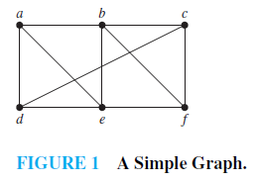
Example
a,d,c,f,e is a path.
d,e,c,a is not a path.
b,c,f,e,b is a circuit.
a,b,e,d,a,b is not a simple path.
School of Computer Science , BUPT

Slide 4
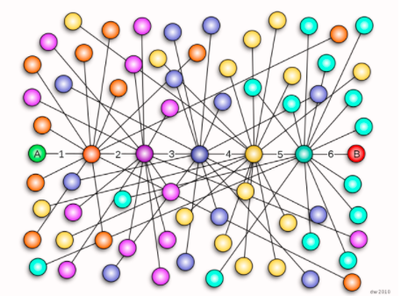
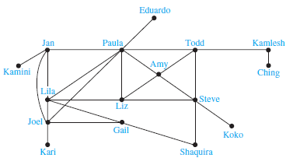
Paths in Acquaintanceship Graphs
  Six Degrees of Separation by John Guare
School of Computer Science , BUPT

Slide 5
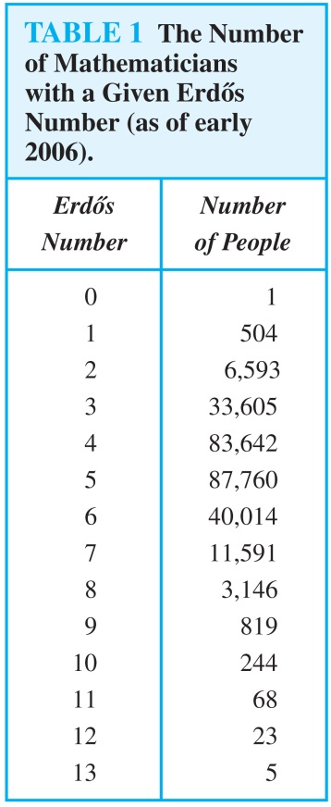
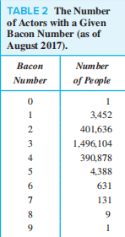
Paths in Collaboration Graphs
  academic collaboration graph of people
    Erdos number
  In the Hollywood graph
    Bacon number

Slide 6
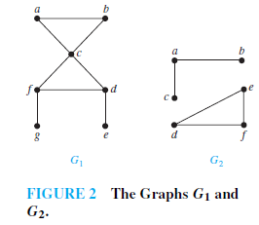
Connectedness
An undirected graph is connected if there is a path between every pair of distinct vertices in the graph.
Example 4, p717
School of Computer Science , BUPT

Slide 7
Theorem: There is a simple path between every pair of distinct vertices of a connected undirected graph.
School of Computer Science , BUPT

Slide 8
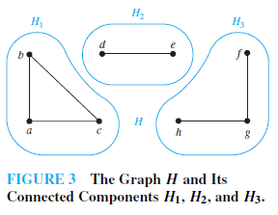
A Connected component of a graph G is a connected subgraph of G that is not a proper subgraph of another connected subgraph of G.
Example 5, p717
Connected Components of Call Graph
School of Computer Science , BUPT

Slide 9
A cut vertex or cut edge (bridge) separates 1 connected component into 2 if removed.
School of Computer Science , BUPT

Slide 10

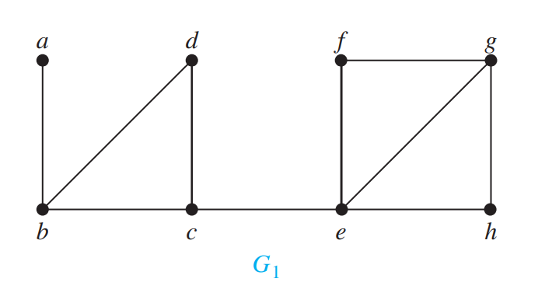
多选题
1分
Find the cut vertices in the graph G₁
A
a
B
b
C
c
D
d
E
e
提交
School of Computer Science , BUPT

Slide 11
多选题
1分
Find the cut edges in the graph G₁
A
a,b
B
b,d
C
c,e
D
f,e
E
e,h
提交
School of Computer Science , BUPT

Slide 12
Vertex Connectivity
  Nonseparable graphs
    Connected graphs without cut vertices are called nonseparable graphs
  Vertex cut
    A subset V′ of the vertex set V of G = (V, E) is a vertex cut, or separating set, if G − V′ is disconnected.
School of Computer Science , BUPT

Slide 13
Vertex Connectivity
  Vertex connectivity
    We define the vertex connectivity of a noncomplete graph G, denoted by 𝜅 (G), as the minimum number of vertices in a vertex cut.
    0 ≤ 𝜅 (G) ≤ n − 1 if G has n vertices
    𝜅 (K_{n}) = n − 1
    𝜅 (G) = 0 if and only if G is disconnected or G = K₁
  A graph is k-connected (or k-vertex-connected), if 𝜅(G) ≥ k.
    Note that if G is a k-connected graph, then G is a j-connected graph for all j with 0 ≤ j ≤ k.
School of Computer Science , BUPT

Slide 14
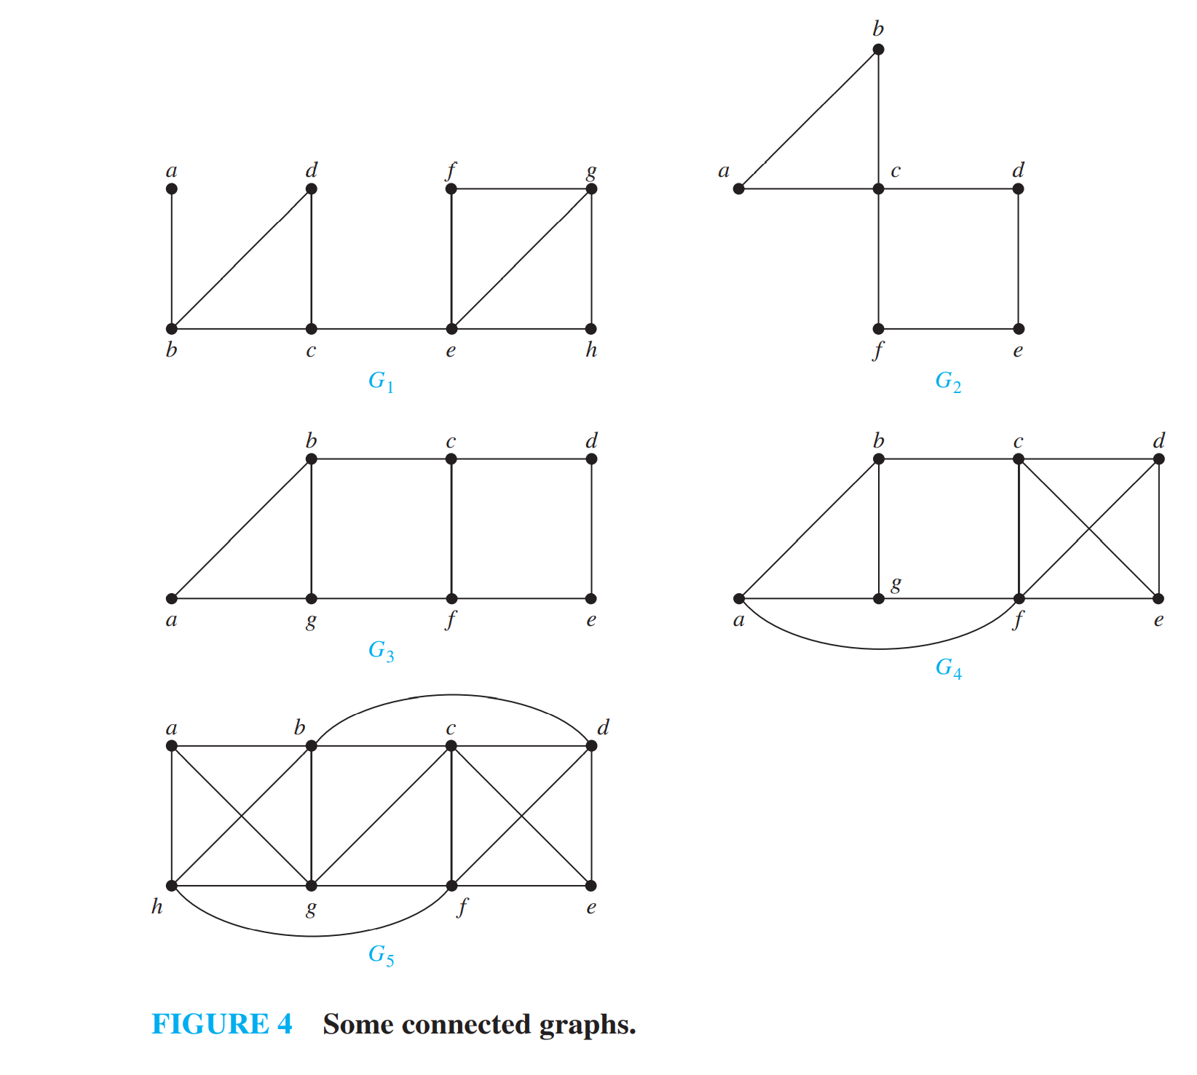
多选题
1分
Determine which graphs in Figure 4 have a vertex connectivity of 2.
A
G₁
B
G₂
C
G₃
D
G₄
E
G₅
提交
School of Computer Science , BUPT

Slide 15
Edge Connectivity
  Edge cut
    A set of edges E′ is called an edge cut of G if the subgraph G − E ′ is disconnected.
  Edge connectivity
    The edge connectivity of a graph G, denoted by 𝜆 (G), is the minimum number of edges in an edge cut of G.
    𝜆 (G) = 0 if G is not connected or G has a single vertex.
    If G is a graph with n vertices, then 0 ≤ 𝜆 (G) ≤ n − 1.
    𝜆 (G) = n − 1 where G is a graph with n vertices if and only if G = K_{n}.
School of Computer Science , BUPT

Slide 16
多选题
1分
Determine which graphs in Figure 4 have a edge connectivity of 2.
A
G₁
B
G₂
C
G₃
D
G₄
E
G₅
提交
School of Computer Science , BUPT

Slide 17
AN INEQUALITY FOR VERTEX CONNECTIVITY AND EDGE CONNECTIVITY
G = (V, E) is a noncomplete connected graph with at least three vertices
  𝜅 (G) ≤ min_{v∈V} deg(v)
  𝜆 (G) ≤ min_{v∈V} deg(v)
G = (V, E) is a noncomplete connected graph
  𝜅 (G) ≤ 𝜆 (G) ≤ min_{v∈V} deg(v)
School of Computer Science , BUPT

Slide 18
APPLICATIONS OF VERTEX AND EDGE CONNECTIVITY
Reliability of networks
  vertex connectivity router
  edge connectivity fiber optic links
Highway network
  vertex connectivity intersections
  edge connectivity roads
School of Computer Science , BUPT

Slide 19
Directed Connectedness
A directed graph is strongly connected if there is a path from a to b and from b to a whenever a and b are vertices in the graph.
It is weakly connected if there is a path between every two vertices in the underlying undirected graph.
Note strongly implies weakly but not vice-versa.
School of Computer Science , BUPT

Slide 20
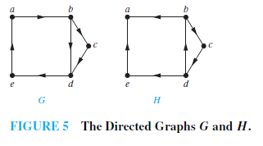
Example 11
  Strongly connected components or strong components
School of Computer Science , BUPT

Slide 21
Example 12
The Strongly Connected Components of the web graph
School of Computer Science , BUPT

Slide 22
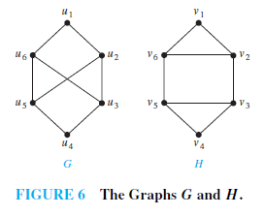
Paths & Isomorphism
Note that connectedness, and the existence of a circuit or simple circuit of length k are graph invariants with respect to isomorphism.
Example 13
School of Computer Science , BUPT

Slide 23
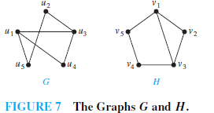
Use paths to find mappings
Example 14,P723
the paths u₁, u₄, u₃, u₂, u₅ in G and v₃, v₂, v₁, v₅, v₄ in H
School of Computer Science , BUPT

Slide 24
Counting Paths by Adjacency Matrices
Let A be the adjacency matrix of graph G.
The number of paths of length k from v_{i} to v_{j} is equal to (A^{k})_{i,j}.
  The notation (M)_{i,j} denotes m_{i,j} where
  [m_{i,j}] = M.
School of Computer Science , BUPT

Slide 25
Proof by mathematical induction
  Basis Step: By definition of the adjacency matrix, the number of paths from v_{i} to v_{j} of length 1 is the (i,j)th entry of A.
  Inductive Step: For the inductive hypothesis, assume that the (i,j)th entry of A^{r} is the number of different paths of length r from v_{i} to v_{j}. A^{r+1} = A^{r} A, the (i,j)th entry of A^{r+1} equals b_{i1}a_{1j} + b_{i2}a_{2j} + ⋯ + b_{in}a_{nj}, where b_{ik} is the (i,k)th entry of A^{r}. By the inductive hypothesis, b_{ik} is the number of paths of length r from v_{i} to v_{k}.
  A path of length r + 1 from v_{i} to v_{j} is made up of a path of length r from v_{i} to some v_{k} , and an edge from v_{k} to v_{j}. By the product rule for counting, the number of such paths is the product of the number of paths of length r from v_{i} to v_{k} (i.e., b_{ik} ) and the number of edges from from v_{k} to v_{j} (i.e, a_{kj}). The sum over all possible intermediate vertices v_{k} is b_{i1}a_{1j} + b_{i2}a_{2j} + ⋯ + b_{in}a_{nj} .

Slide 26
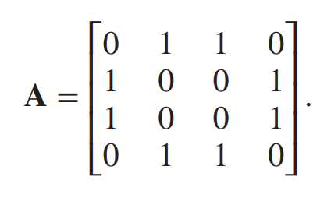

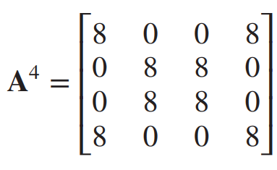
Example 15
How many paths of length four are there from a to d in the simple graph G in Figure 8?
School of Computer Science , BUPT

Slide 27
Homework
14,28,36,60
School of Computer Science , BUPT

